Slide 1
CS122 - Final Project: Explore descriptive statistics
Thuy Vu

Slide 2
Introduction and Tasks
Analyzing data on air quality with respect to carbon monoxide, a major air pollutant, for US Environmental Protection Agency.
The data includes information from more than 200 sites, identified by state, county, city, and local site names.

Slide 3
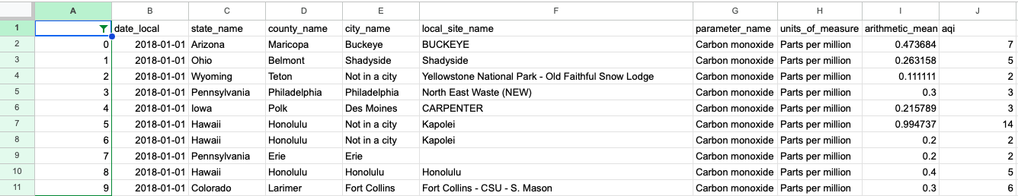

Slide 4
What is AQI?
According to airnow.gov, “every day the Air Quality Index (AQI) tells you how clean or polluted your outdoor air is, along with associated health effects that may be of concern. ”
Air quality is important because “local air quality affects how you live and breathe. Like the weather, it can change from day to day or even hour to hour.”

Slide 5
SUMMARY
Mean: 6.76
Median: 5
Mode: 2
Standard deviation: 7.0617
25th percentile: 2
75th percentile: 9
Max: 50
Min: 0

Slide 6
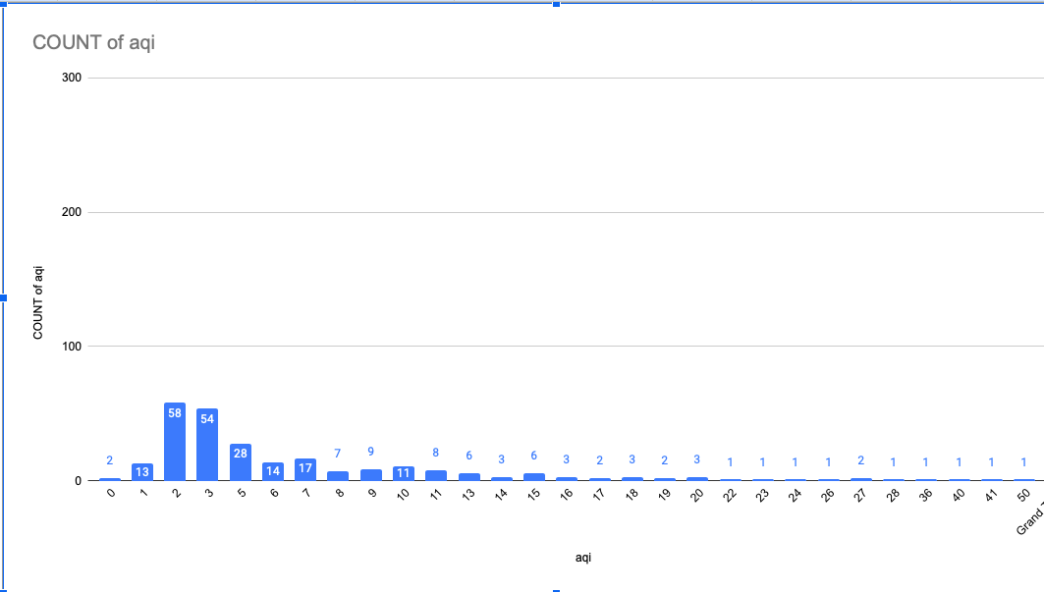

Slide 7
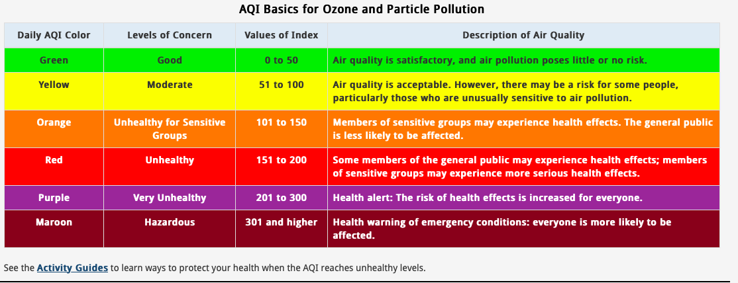

Slide 8
Conclusions
All of the aqi values in this dataset were in the healthy range, between 0 and 50.
The mean is greater than the median. (6.76>5)
Both of the mean and the median are closer to the minimum compared to the maximum data point. (z-score ~ -0.71 vs z-score ~ 6.37)

Slide 9
Conclusions (Cont)
The majority of data is concentrated on the left side of the graph. This distribution is right-skewed or positively skewed.
Hence, we have more data points with smaller values compared to those with the larger values.

Slide 10
Why is the distribution positively skewed?
The dataset might be biased.
Some states only have one datum
California, alone, makes up approximately 25% of the dataset (66/260)
More data points might be needed for other states

Slide 11
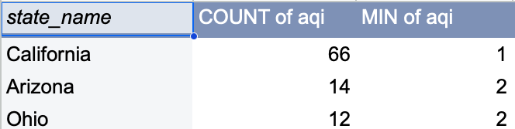
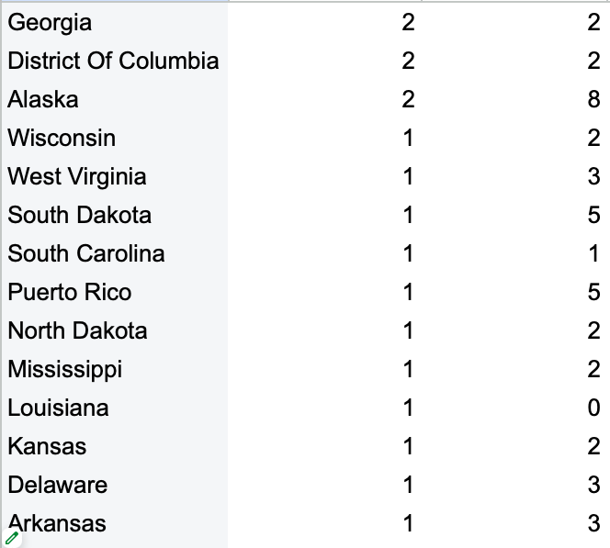
Comparing

Slide 12
Reference
Airnow.gov
https://docs.google.com/spreadsheets/d/1EOaQ6OpI_oagp9HNp67UlKQNSrvLtZkbyaz6tKSAn6s/edit?usp=sharing

Slide 13
Thank you for your attention!

